Slide 1
DESTINATION TRAINING GUIDES
Save valuable time & money by pre-booking your customers’ experiences ..
Benefit from UK EXCLUSIVE, money saving offers ..
Many popular attractions sell out in advance – make sure your customers don’t miss out!

Slide 2
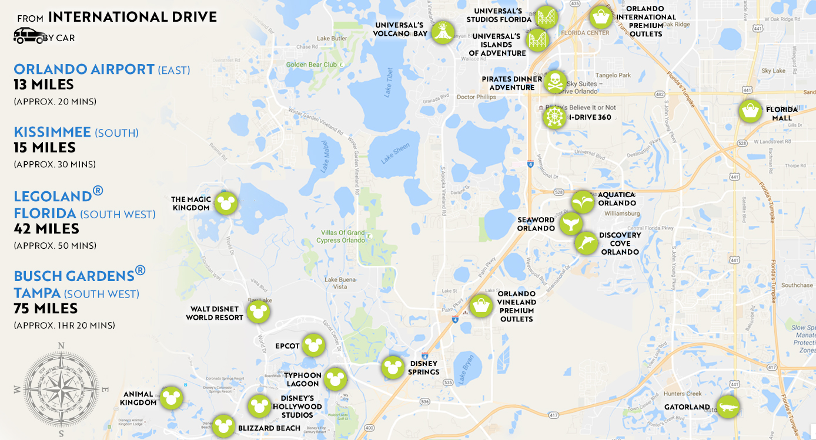
With so much to see and do choosing the correct theme park ticket options can be a minefield – particularly for customers who have never been before. In the following guide we will aim to unravel the mystery of each ticket and hopefully help you offer the best choices to your customers. Never forget our packaged options if customers really want to experience it all and get the best value for money their pounds can buy. It may seem a costly sum at first but broken down to a cost per day over 14 days to visit the very best theme parks in the world, it’s unbeatable value for money – take it from the experts!

Slide 3
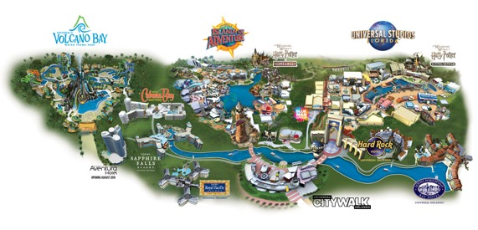
WALT DISNEY WORLD RESORT IN FLORIDA MAPS
Epcot
Magic Kingdom Park
Disney's Animal Kingdom
Disney's Hollywood Studios
UNIVERSAL ORLANDO RESORT™
MAPS
Universal Studios Florida™
Universal's Islands of Adventure™
Universal's Volcano Bay™
HARRY POTTER characters, names and related indicia are © & Warner Bros. Entertainment Inc. Harry Potter Publishing Rights © JKR. (s19)
© 2019 UCF Hotel Venture V. UNIVERSAL & © Universal Studios. ENDLESS SUMMER registered trademarks, Bruce Brown Films, LLC. All rights reserved. Aventura Hotel & © 2019 UCF Hotel Venture IV. All rights reserved. Cabana Bay Beach Resort & © 2019 UCF Hotel Venture II. All rights reserved. Sapphire Falls Resort & © 2019 UCF Hotel Venture III. All Rights Reserved. Portofino Bay Hotel and Royal Pacific Resort & © 2019 UCF Hotel Venture. All rights reserved. Hard Rock Hotel ® Hard Rock Cafe International (USA), Inc. Royal Pacific Resort & © 2019 UCF Hotel Venture. All rights reserved.

Slide 4
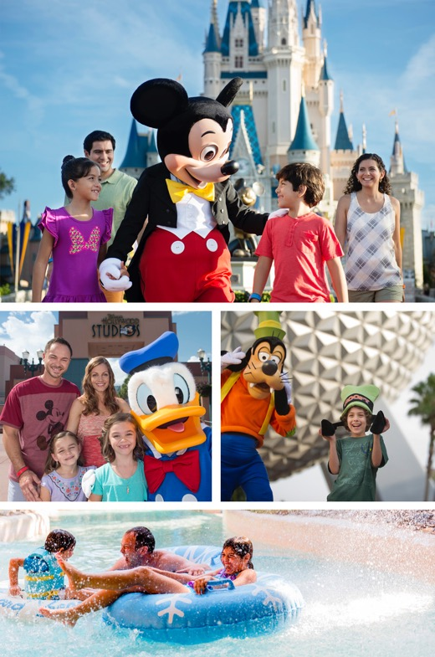
WALT DISNEY WORLD RESORT 14 DAY ULTIMATE TICKET
EVERYONE young and old wants to visit Disney! This 14-day ticket offers unbeatable value for money and can only be purchased in the UK. It allows you literally to come and go as little or as often as you please over a 14 consecutive day period. You can enjoy 4 Disney theme parks (Magic Kingdom, Epcot, Disney’s Animal Kingdom and Disney’s Hollywood Studios) plus 2 water parks (Disney’s Blizzard Beach and Disney’s Typhoon Lagoon) plus other Disney attractions including ESPN Wide World of Sports Complex and a round of mini golf (a day) at any of the 3 golf courses situated within Walt Disney World Resort.
Just remember your customers only need to use their 14 day ticket 4 times to get value for money – so you can see what an excellent value for money ticket this really is! (The 14 day ticket currently works out at less than £28 per day/adult. To buy a ticket on the gate is approximately $120 + tax – which equates to approximately £95 per day/adult).
*Guests staying on site at Walt Disney World Resort hotels will have access to this service 60 days prior to departure.
not only does it save you serious money on purchasing your tickets in resort but you can also take advantage of MyMagic+ and pre-book your fast passes for all your favourite rides 30 days prior to departure!* You also benefit from FREE Memory Maker for all your Disney photos, worth $169 when you buy in resort!
©Disney
FOR CUSTOMERS WHO WANT TO SEE AND DO IT ALL AT DISNEY, UNIVERSAL ORLANDO and SEAWORLD PARKS** - DON’T FORGET TO OFFER OUR BEST SELLING PACKAGE – THE ORIGINAL ONE – FOR EVEN BETTER VALUE FOR MONEY THAN BUYING TICKETS INDIVIDUALLY! (**Excludes Discovery Cove). All savings messages in this guide are based on gate rates as at 1 September 2016 and an exchange rate of 1.35).

Slide 5
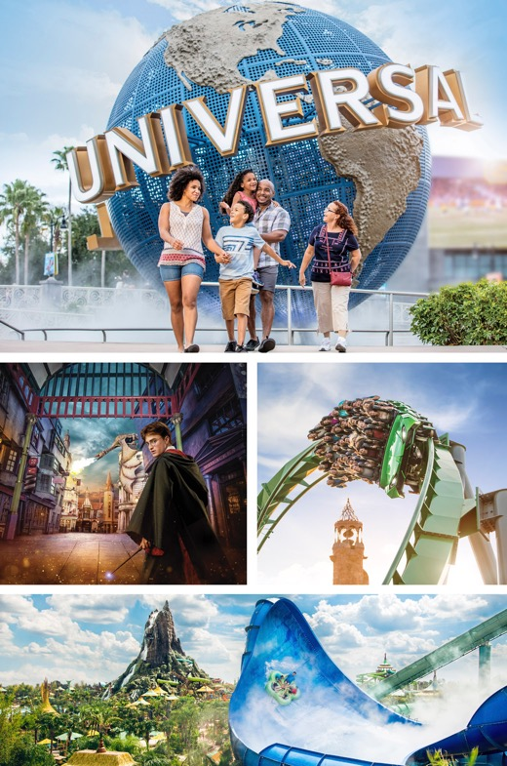
UNIVERSAL ORLANDO 2 & 3-PARK EXPLORER TICKETS
In a nutshell the 3-park Explorer ticket consists of unlimited admission for 14 consecutive days to
Universal Studios Florida, Universal’s Island’s of Adventure theme parks and Universal's Volcano Bay
water theme park. This ticket also includes admission to select live entertainment venues of Universal
CityWalk.
The 3-Park Explorer ticket currently works out at less than £19 per day/adult. To buy a ticket on the gate is $150 + tax – which equates to approximately £118 per day/adult).
If your customers are visiting Universal Orlando Resort and wish to visit Universal's Volcano Bay water
theme park they should purchase the Universal Orlando 3 Park Explorer Ticket for the price of a 2 Park
Explorer Ticket!
Valid for admission up to and including 31 December 2018. Terms and conditions apply. For 2019 travel, speak to travel professional.
the ‘Universal Orlando Explorer Tickets’ are much better value than paying at the gate.
HARRY POTTER characters, names and related indicia are © & ™ Warner Bros. Entertainment Inc. Harry Potter Publishing Rights © JKR. (s18)
Universal elements and all related indicia & © 2018 Universal Studios. All rights reserved.
FOR CUSTOMERS WHO WANT TO SEE AND DO IT ALL AT DISNEY, UNIVERSAL ORLANDO and SEAWORLD PARKS* - DON’T FORGET TO OFFER OUR BEST SELLING PACKAGE – THE ORIGINAL ONE – FOR EVEN BETTER VALUE FOR MONEY THAN BUYING TICKETS INDIVIDUALLY! (*Excludes Discovery Cove). All savings messages in this guide are based on gate rates as at 1 September 2016 and an exchange rate of 1.35).

Slide 6
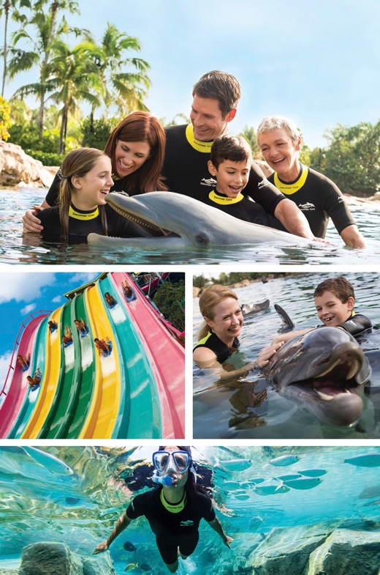
DISCOVERY COVE ULTIMATE PACKAGE
This is our most popular ticket for those that want to swim with the dolphins as not only do you get to spend a full day at the all-inclusive, family tropical paradise famously known as Discovery Cove ® Orlando, but you can also enjoy 14 days unlimited admission to SeaWorld® Orlando, Aquatica™ and Busch Gardens® Tampa Bay (including FREE transportation to Busch Gardens for those who don’t want to hire a car!)
Everyone wants to swim with the dolphins but this experience is so much more - not only do you learn all about our bottle nosed friends and get to have your own swim and playtime with them, but it truly feels like you have entered paradise with the shoals of tropical fish, turquoise waters and exotic birds singing their hearts out. What’s more you can enjoy a full day of all-inclusive service from breakfast through to tea time – truly delicious food too – this certainly cannot be classed as junk food!
So even if your customers only use their 14 day ticket to spend their day at Discovery Cove and visit the other 3 parks just once, they are already saving themselves a small fortune in doing so when you consider the gate rates for 1 day entries are approximately £75 plus £15 parking per day!
*Saving based on cost of parking at Busch Gardens® Tampa Bay during peak park opening dates.
not only does pre-booking guarantee you entry to this very popular attraction that sells out months in advance during peak seasons, but you can also enjoy FREE parking at the parks – SAVING YOU up to $20 PER DAY!*.
© 2017 SeaWorld Parks & Entertainment Inc. All rights reserved.
DON’T FORGET THIS IS AN ALL-INCLUSIVE EXPERIENCE INCLUDING ALL FOOD & DRINKS (SOFT DRINKS ONLY), THE USE OF ALL EQUIPMENT SUCH AS WETSUITS AND SNORKELS, TOWELS AND SWIM VESTS, BEACH CHAIRS, LOCKERS, FREE PARKING AND EVEN DOLPHIN FRIENDLY SUNSCREEN! Alcohol can be purchased though for guests (OVER 21) who enjoy a drink.
All savings messages in this guide are based on gate rates as at 1 September 2016 and an exchange rate of 1.35).

Slide 7
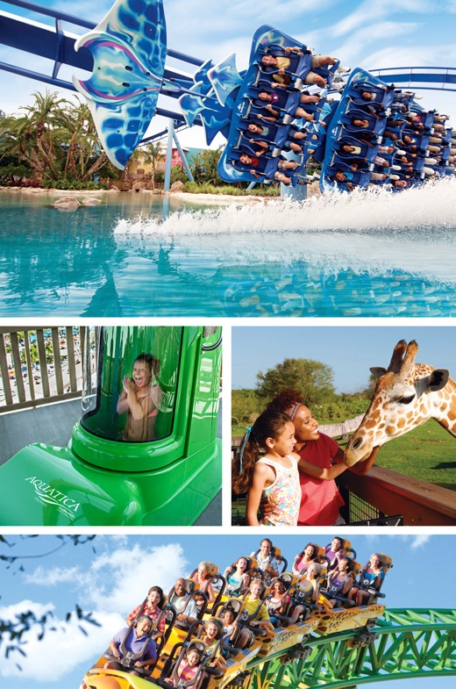
SEAWORLD® ORLANDO, AQUATICA™ & BUSCH GARDENS® TAMPA BAY 3 PARKS FOR 2!
For those who love animals and white knuckle rides a visit to Busch Gardens® Tampa is a MUST! The Serengeti Safari experience is the closest you will get to Africa without actually going there (again advisable for customers to pre-book as it is an extra cost but so popular it does sell out). Aquatica™ is a beautiful water park that caters particularly well for the youngsters but saying that has its own fair share of water thrills and spills for those more energetic amongst us! SeaWorld® Orlando is the most well-known of the 3 parks featuring of course Shamu, but there is plenty more to see and do there including feeding the dolphins, the penguin encounter and of course the park has its own fair share of roller coasters including Kraken, Mantu and new for this year, Mako™.
But DID YOU KNOW for the past 50 years SeaWorld Parks & Entertainment have been actively involved in wildlife conservation? To date they have raised over $11m that has helped over 800 organisations. They have also rescued over 28,000 wild animals. Pretty impressive stuff that not a lot of people know about ..
*Saving based on cost of parking at Busch Gardens® Tampa Bay during peak park opening dates.
not only do you get 3 fantastic parks for 14 consecutive days for the price of 2, but you can also enjoy FREE bus transportation to Busch Gardens® Tampa on the Busch Gardens Shuttle Express PLUS FREE parking at the parks – SAVING YOU up to $20 PER DAY*!
© 2017 SeaWorld Parks & Entertainment Inc. All rights reserved.
DON’T FORGET TO OFFER YOUR CUSTOMERS THE ALL-DAY DINING OPTIONS AT ALL 3 PARKS. EATING & DRINKING CAN BE EXPENSIVE IN THE PARKS BUT THESE EXTRAS OFFER UNBEATABLE VALUE FOR MONEY FOR AS MUCH AS YOU CAN EAT AND DRINK DURING THE DAY (SOFT DRINKS ONLY INCLUDED).
(All saving messages in this guide are based on gate rates as at 1 September 2016 and an exchange rate of 1.35).

Slide 8
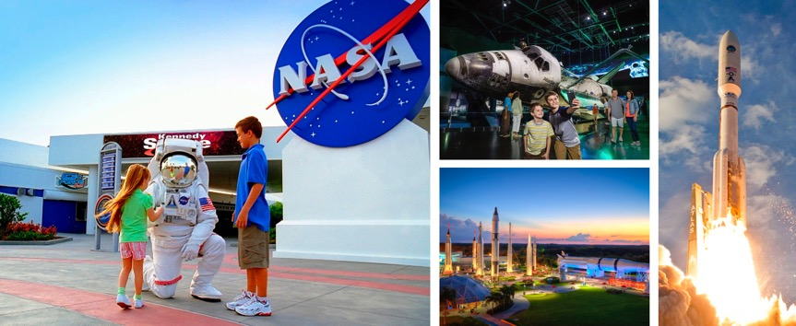
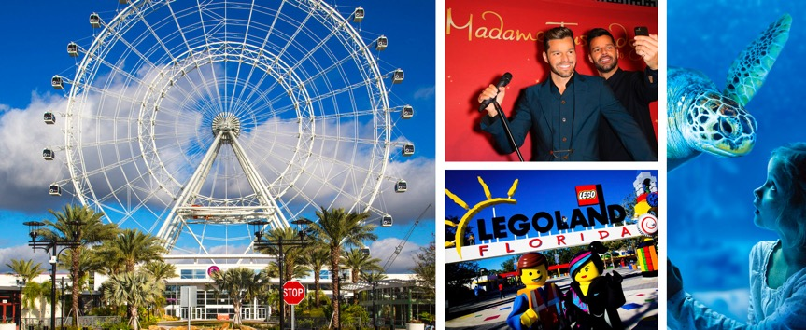
KENNEDY SPACE CENTER
Kennedy is located approximately 45 minutes from Orlando and is certainly worth a day away from the theme parks. Not only can you get up close and personal to a real live astronaut but you can see the $100m Space Shuttle Atlantis for yourself and spend a full day exploring the past, present and future of the US Space Programme. We also offer tickets that include dining with an astronaut so you get to hear tales of Space right from the horse’s mouth!
I-DRIVE 360 ATTRACTIONS INC. LEGOLAND
So what’s included?
The Orlando Eye (Orlando’s version of the London Eye) offering panoramic views over central Florida
Madame Tussauds – a fully interactive experience with waxworks that look more real than the stars themselves
SEA LIFE Orlando Aquarium where you can get to see over 5,000 creatures from sharks to sea turtles and seahorses! .
tickets that include transport to the Centre also offer an exclusive “Meet & Greet an Astronaut” experience – completely free of charge! And it’s Kennedy Space Center after all – where history is made!
when you pre-purchase tickets to the
I-Drive attractions you receive FREE parking AND you can choose when you want to visit them (no need to book exact date) PLUS you can add on a day at LEGOLAND® Florida and enjoy FREE roundtrip transportation!

Slide 9
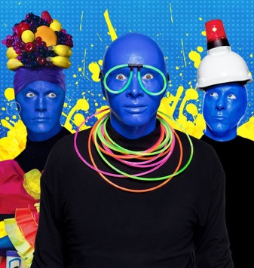
©2018 BMP. Blue Man Group photos by Lindsey Best. Universal elements and all related indicia TM & 2019 Universal Studios. All rights reserved.
KIDS EAT FREE CARD PLUS ORLANDO
This is our best value dining card that allows kids to eat FREE in Orlando and enjoy FREE Kids
deals at participating attractions too (including Orlando Balloon Rides, WonderWorks and
Gatorland)! With over 120 restaurants to choose from your spoilt for choice! One card per
child is all you need and is valid for 90 days once activated.
Only condition being one adult meal per FREE child meal needs to be purchased.
BLUE MAN GROUP AT UNIVERSAL ORLANDO
when you pre-book your tickets to this show you don’t need to decide on a particular date – wait until you get to the resort and decide then, offering you the ultimate flexibility when on holiday! PLUS enjoy savings of
over 20% off the gate rate!
Blue Man Group will rock your world. Blow your mind. And unleash your spirit. As three bald and blue men explore our world, together we’ll discover music, laughter and surprises at every turn. By the end of this spectacular journey, you’ll be saying “I DON’T EVEN KNOW WHAT JUST HAPPENED BUT I LOOOVED IT.”
35 million people of all ages, languages and cultures have experienced the imaginative, multisensory world of Blue Man Group. Now it’s your customer's turn to see what all the hype is about.
by pre-booking you’ll pick your card up for almost 50% CHEAPER than buying in resort!
DARE TO LIVE IN FULL COLOUR.

Slide 10
ALWAYS recommend your customers pre-purchase their theme park tickets. These tickets offer UNBEATABLE VALUE and simply CANNOT be purchased in resort. Don’t forget to look at our packages too for even more money-saving options.
Don’t forget to offer the all-day dining options for guests visiting Seaworld® Orlando, Aquatica™ & Busch Gardens® Tampa Bay. Again these are fantastic value for money ticket options particularly for families with hungry/thirsty kids!
For customers not hiring cars many of our ticket options that are not within the immediate Orlando area offer FREE TRANSPORTATION if booked in advance. Also worth noting is the I-RIDE TROLLEY which allows guests to hop on/off at all the main attractions located along I-Drive at a very low price for the duration of their holiday. Kids up to the age of 9 years can travel for just $1 per ride!
We have only scraped the surface of Florida attractions in this guide focussing on first-timers who want to make the most of the theme parks in Florida so please take a look at our website for full details on all the great things to do that we simply cannot fit into this brief overview.
And last but not least - did you know that Walt Disney World Resort in Florida is the same size as greater Manchester and actually covers 47 square miles? So you can see it is ESSENTIAL that customers take the time to plan their itinerary and it’s up to you as their travel agent to ensure they make the most and have the BEST TIME OF THEIR LIVES …
LET’S GET #ATTRACTIONPACKED

