Slide 1
DESTINATION TRAINING GUIDES
Save valuable time & money by pre-booking your customers’ experiences ..
Benefit from UK EXCLUSIVE, money saving offers ..
Many popular attractions sell out in advance – make sure your customers don’t miss out!

Slide 2
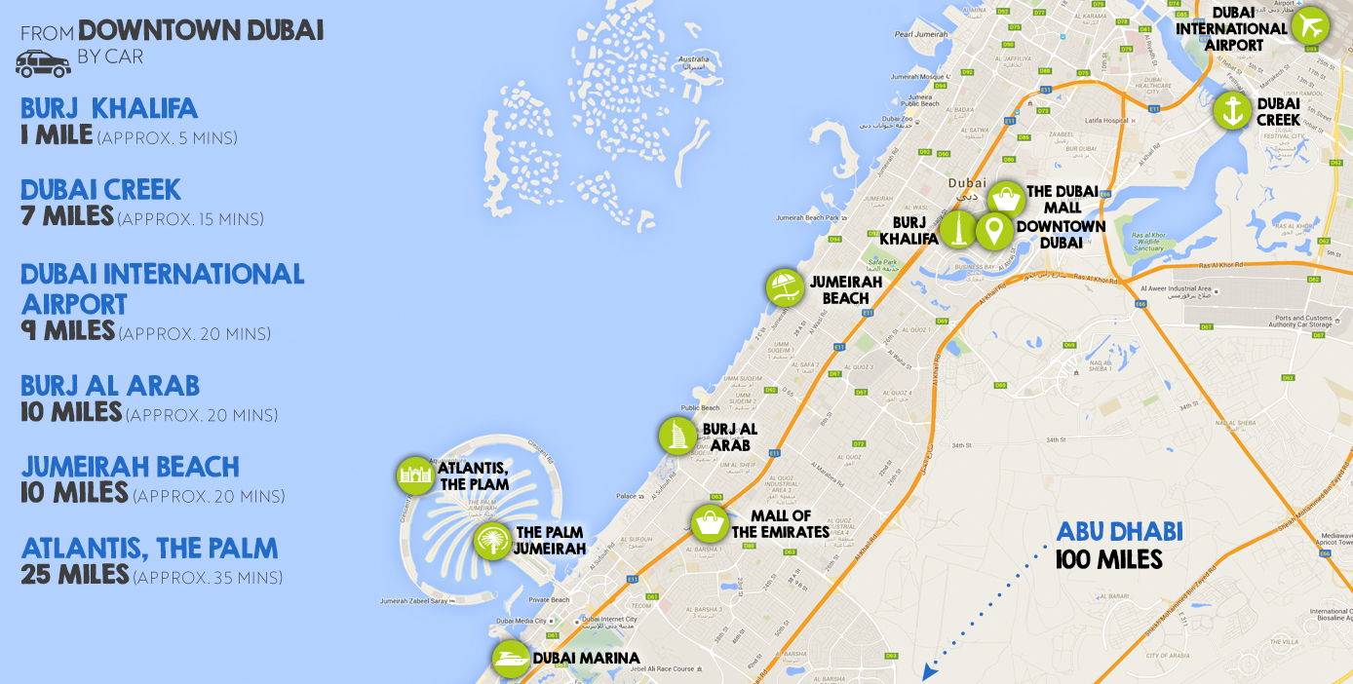
Dubai is a city in the United Arab Emirates known for luxury shopping, ultramodern architecture and a lively nightlife scene. Customers tend to stay either in the city or at the beach. The Airport is actually situated in Deira (which is part of ‘Dubai’) and is approximately 20-30 minutes from Dubai ‘centre’ – depending whether your customers are staying in the city or at the beach. Taxi’s are readily available and fares are very reasonable.

Slide 3
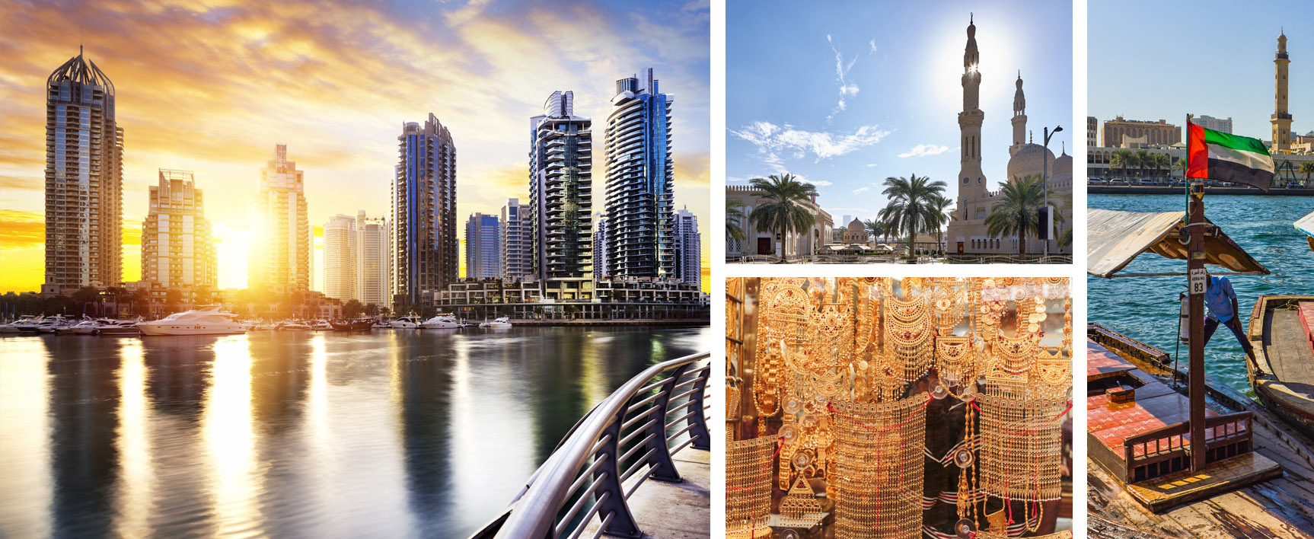
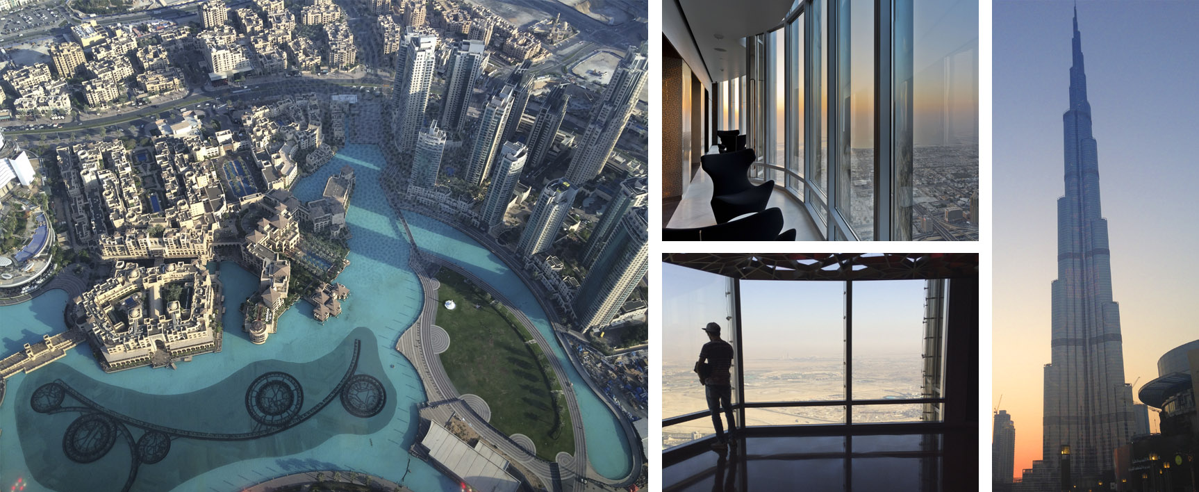
BEST OF DUBAI - CITY TOUR & CRUISE
From the beach to the creek, to the city, this 4-hour tour guided by locals will give you an invaluable insight into Dubai. Couple this with a traditional Dhow Dinner Cruise on the Creek with an award winning buffet dinner and unbeatable views of the city – a definite winning combo!
BURJ KHALIFA
Experience panoramic views like no other on the observation terrace 452m above the ground! Check out other ticket options including Burj Khalifa SKY 148th Floor Observation Deck - the highest you can get without boarding a plane! Plus dining options at the Armani restaurant and other key attractions.
you get to experience two of our top selling tours at a discounted price not available in resort!
pre-booking is essential if you want to visit the tallest building in the world. Customers who leave it until they get to resort are often disappointed as it sells out.

Slide 4
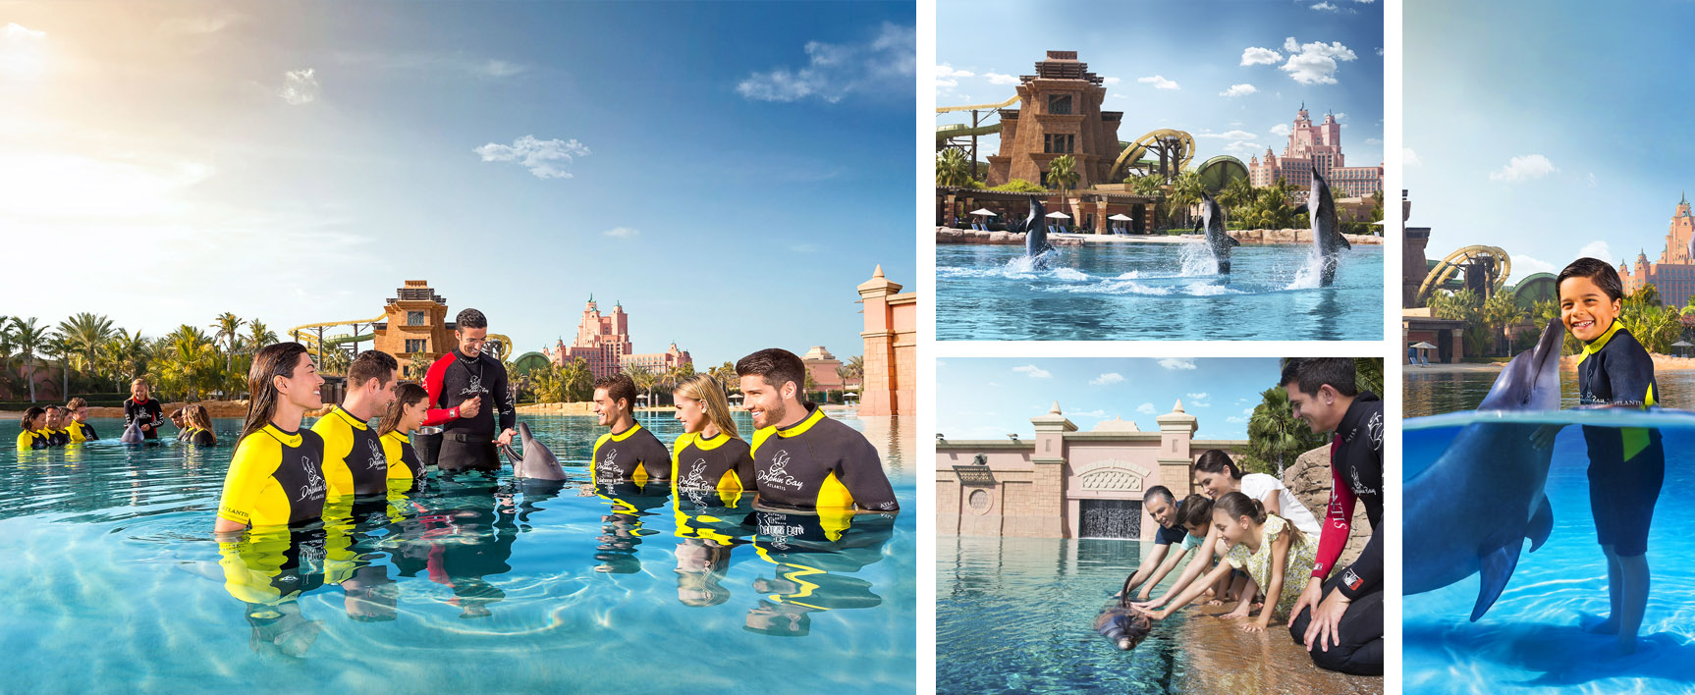
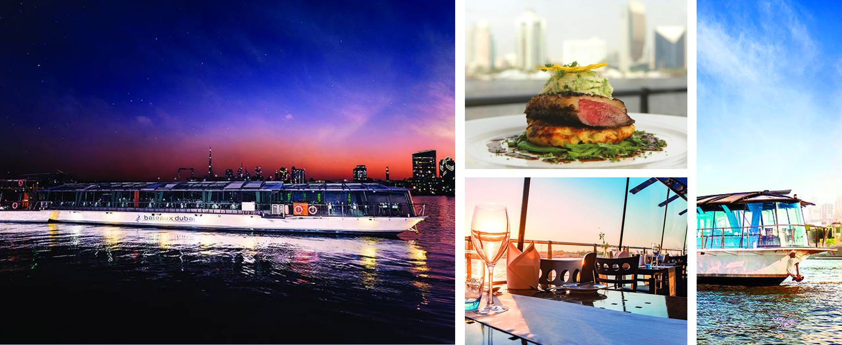
ATLANTIS THE PALM DOLPHIN EXPERIENCES
This amazing resort is another MUST-DO. Whether you want to spend a day swimming with the dolphins or simply just spend a day at the waterpark and The Lost Chambers Aquarium make sure your customers pre-purchase to get the best money saving tickets and value-added offers.
BATEAUX DUBAI DINNER CRUISE
Another not to be missed experience in Dubai! Enjoy spectacular 360-degree views of Dubai as you dine on an exquisite a la carte 4-course dinner whilst sailing majestically down the magnificent Dubai Creek. The cruise lasts approximately 2½ hours. Dress code – smart. No sleeveless tops, shorts or flip-flops! *Max. 4 guests per table for window seating.
it’s the ONLY water park in Dubai to offer dolphin experiences and is essential to pre-book if you want to enjoy this popular attraction. PLUS booking an experience ensures a complimentary ticket to the waterpark – worth over £40!
when you book with us we guarantee you complimentary window seating for THE BEST views of Dubai!*

Slide 5
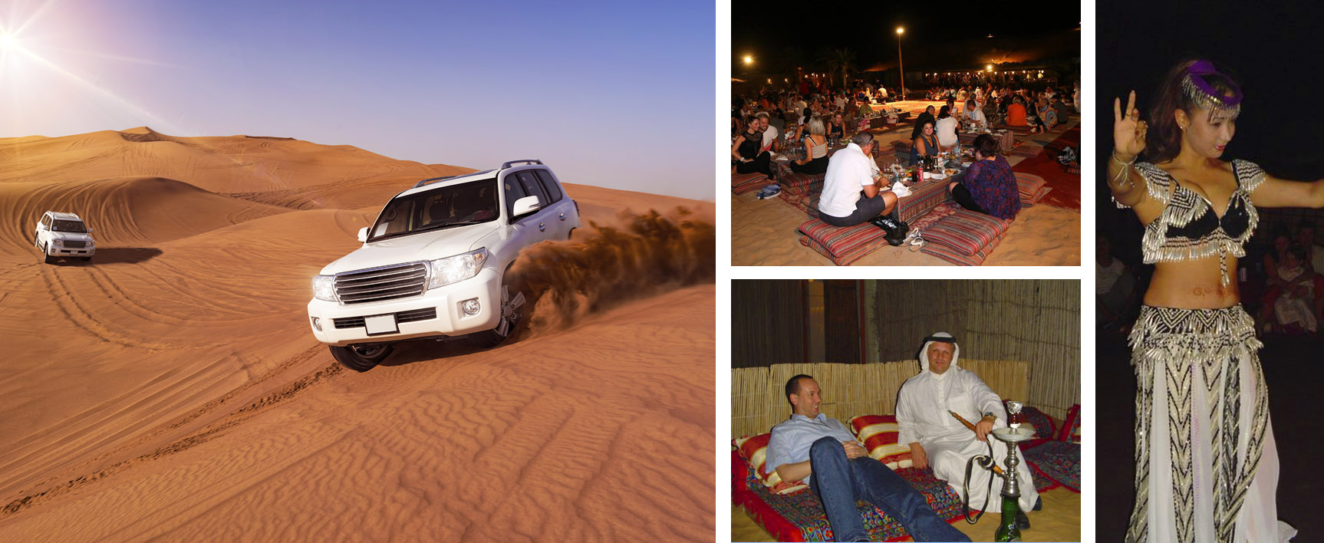
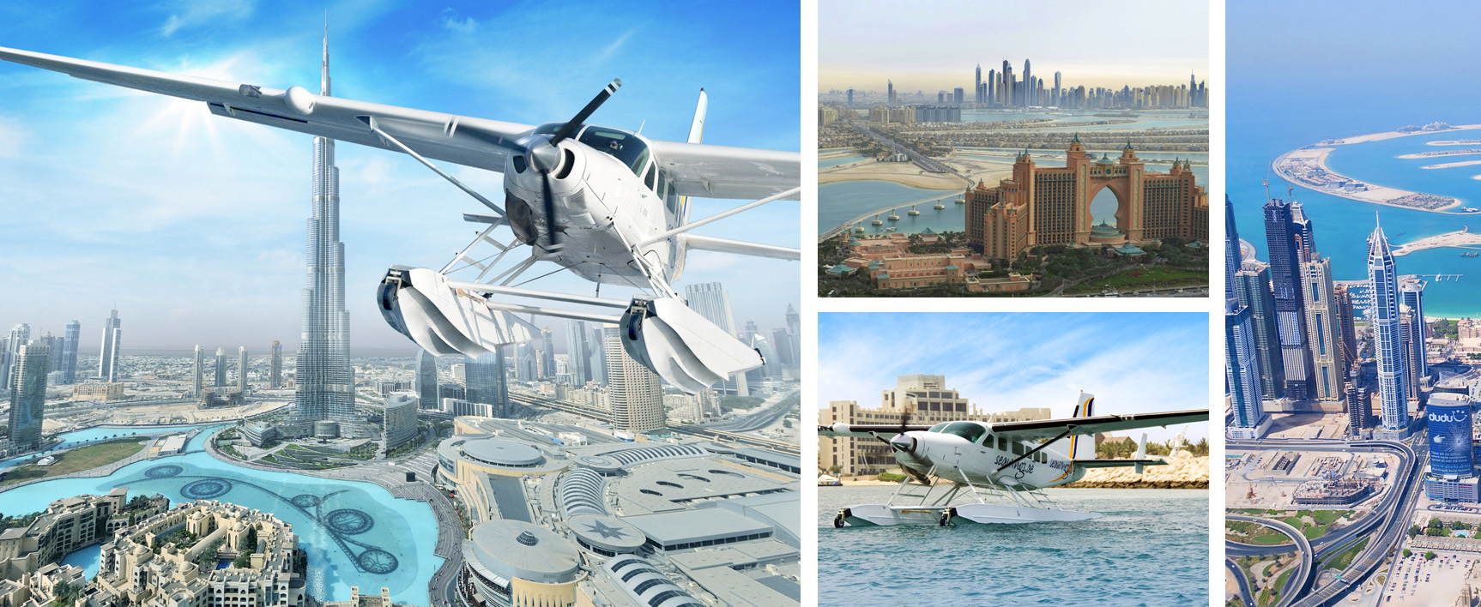
SUNSET SAFARI & BBQ DINNER
Enjoy an exciting ride on the sand dunes in a 4x4 jeep, see the sun set over the desert, plus a delicious BBQ dinner, followed by Arabic entertainment. Tour runs daily and includes round-trip transportation from Dubai hotels. Set off is usually around 3pm, drop off around 9.30pm.
SEAWINGS SILVER SEAPLANE TOUR
Enjoy a 40-minute flight that showcases the highlights of Dubai from the air! Don’t miss the impressive manmade islands of Palm Jumeirah and the World – an amazing structure that recreates the world map in miniature! Tours run daily, weather dependent, from the Dubai Creek Golf & Yacht Club or the Jebel Ali Golf Resort (whichever is more convenient).
so many extras are included free of charge, such as belly dancing, shisha smoking, sand boarding and a whirling Darwish show – all in true Arab style!
it comes with COMPLIMENTARY return transfers (a saving of approximately £30 per person!)

Slide 6
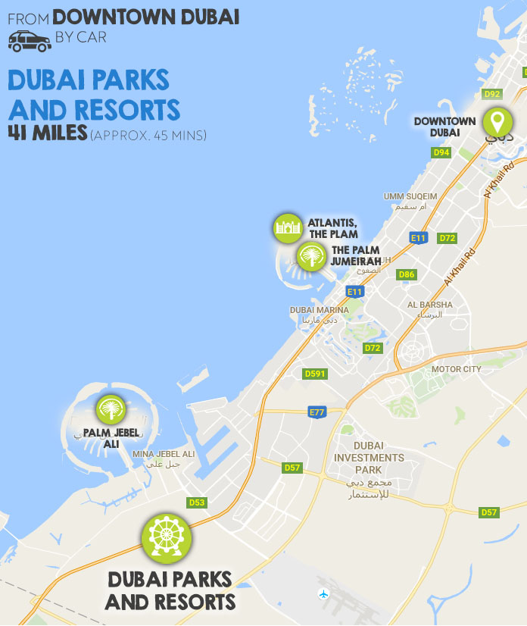
DUBAI PARKS AND RESORTS - OVERVIEW
A very exciting new development will literally open its doors in December 2016 – 25 million square feet of theme parks where East definitely meets West! This is one of the largest integrated theme park resorts in the world located on the famous Sheikh Zayed Road, opposite the Palm Jebel Ali. Comprising 3 separate theme parks (LEGOLAND® DUBAI, Bollywood PARKS™ DUBAI and motiongate™ DUBAI) plus LEGOLAND® WATER PARK.
As with any multi-park resort there are many different ticket options to suit every type of guest whether that be a 1-day, 1-park, or indeed a 1-day, 3-park, all the way up to a 4 Day, 3-park ticket for guests who mean business. Every ticket option we offer comes with the benefit to your customer of being CHEAPER than buying at the gate.

Slide 7
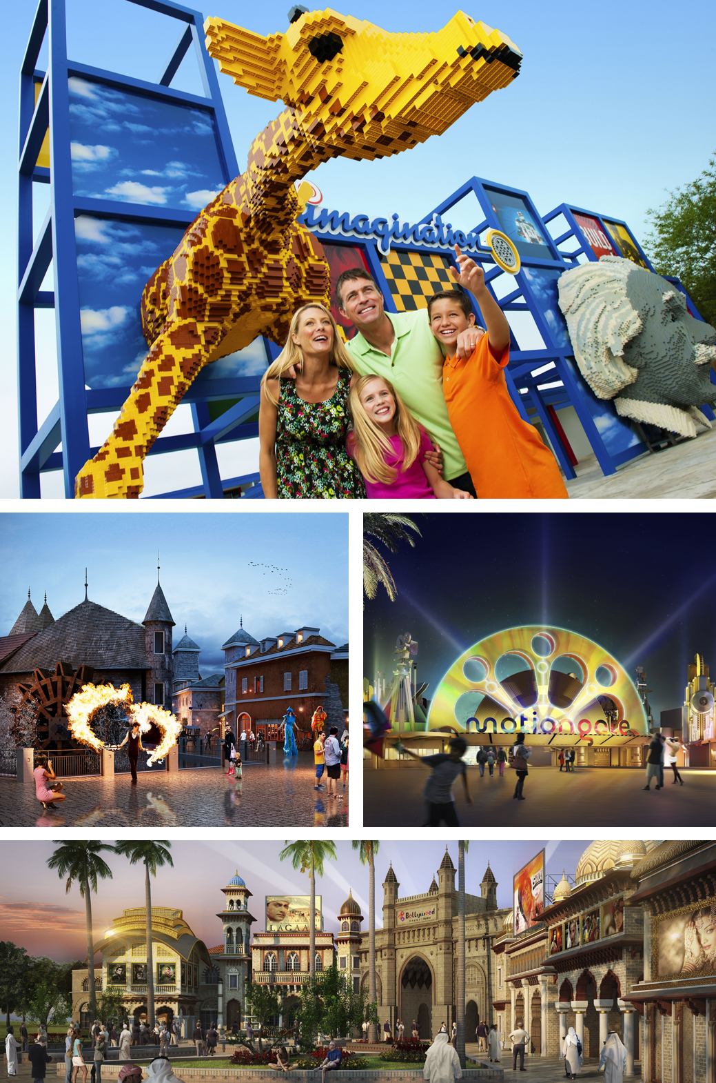
LEGOLAND® DUBAI AND LEGOLAND® WATER PARK
Head to LEGO® City where you can fly a plane, steer a boat and save a burning building! Over at IMAGINATION you can build and race your own LEGO® car. And don’t forget to save the day in the medieval land of KINGDOMS. In ADVENTURE your young explorers can join the LEGO® divers on an underwater adventure. Plus no day would be complete without a visit to MINILAND – the first ever indoor interactive area made up of 20 million LEGO® bricks! The LEGOLAND® WATER PARK boasts over 20 slides and attractions and is the only water park of its kind in the UAE.
both these parks are designed specifically for 2-12 year olds to enjoy with their families. LEGOLAND® DUBAI has over 40 LEGO® themed rides, shows, building experiences and LEGOLAND® attractions. Visit the FACTORY to see how LEGO bricks are made.
BOLLYWOOD PARKS™ DUBAI
In MUMBAI CHOWK you can stroll the streets of Mumbai enjoying the party atmosphere with its famous food and shopping. You can even join the mafia boss Don on a mad chase through the streets! In RUSTIC RAVINE the spirit of rural India comes to life and you can be part of the never-ending adventures as played out in Dabangg, Lagaan and Sholay. Then in ROYAL PLAZA you can enjoy the first Broadway-style Bollywood musical. Last but not least at BOLLYWOOD FILM STUDIOS you will learn how to create a Bollywood blockbuster with some Bollywood superheroes!
this is the first park in the world dedicated to all things Bollywood! The park is split into 5 zones all inspired by their own Bollywood blockbusters. In BOLLYWOOD BOULEVARD you can enjoy a drink or a bite to eat in one of the many vibrant cafés whilst enjoying some live entertainment.
Motiongate™DUBAI
This park takes you through the whole history of film making starting with real live movie sets in New York and offers fascinating insight into the workings of a movie studio. At Sony Pictures Studios you can literally step onto the set of some of your favourite movies such as Ghostbusters, Green Hornet and Underworld! There is also a fantasy world where the Smurfs live – offering 5 interactive attractions for all generations. Not forgetting DreamWorks where you can play the hero and save the day with 12 mind-blowing attractions! And at Lionsgate it’s all about The Hunger Games and dance favourites with the Step Up trilogy.
A powerful combination from 3 of the most successful movie studios in Hollywood – Dreamworks, Sony Picture Studios and Lionsgate.

Slide 8
Guests tend to stay either at the beach or in Downtown Dubai. Customers must be prepared to wait in traffic if taking taxis as transportation isn’t great in Dubai but is slowly improving with the introduction of the Dubai Tram in 2014.
Although Dubai is classed as a year round destination temperatures do soar during the summer months (from hot to hotter) so the best time to visit Dubai is between November and March.
Never under-estimate the power of pre-booking! Why wouldn’t you want to GUARANTEE your customers the attractions they want to do WHEN they want to do them?
Don’t forget that Dubai has a dress code based on respect for the culture and religion of the UAE. It is important that your customers respect this code and dress appropriately. No tight fitting or transparent garments and no low cut dresses for the ladies in public areas. (Inside your own hotel’s grounds it’s a far more relaxed dress code).
So much is happening right now in Dubai that will make for exciting times ahead! It is reported that 20% of all the cranes in the whole wide world are currently in Dubai - how’s that for building work!
LET’S GET #ATTRACTIONPACKED

